Slide 1

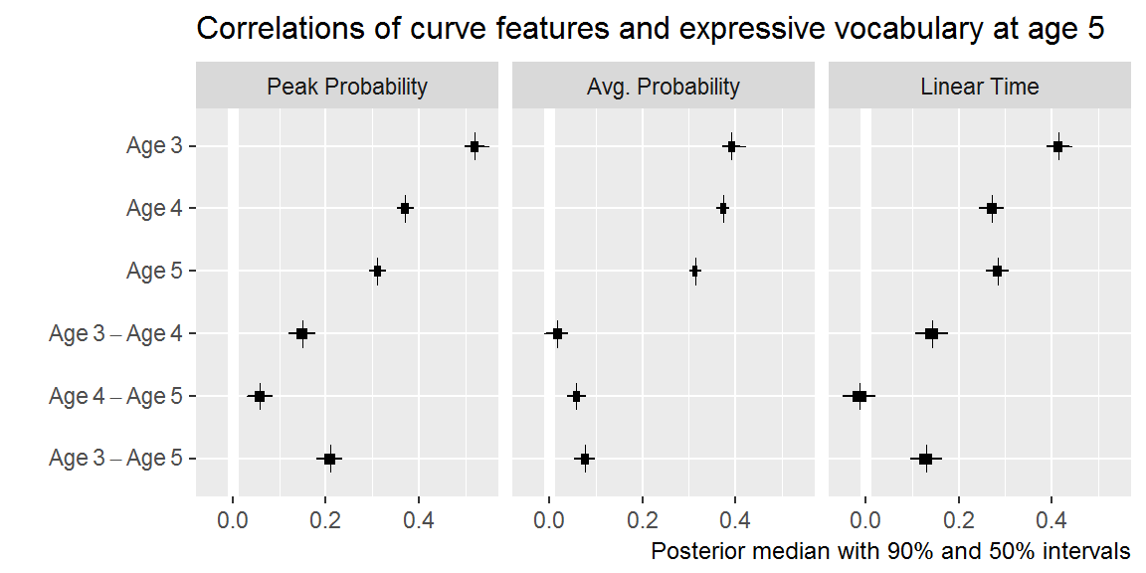
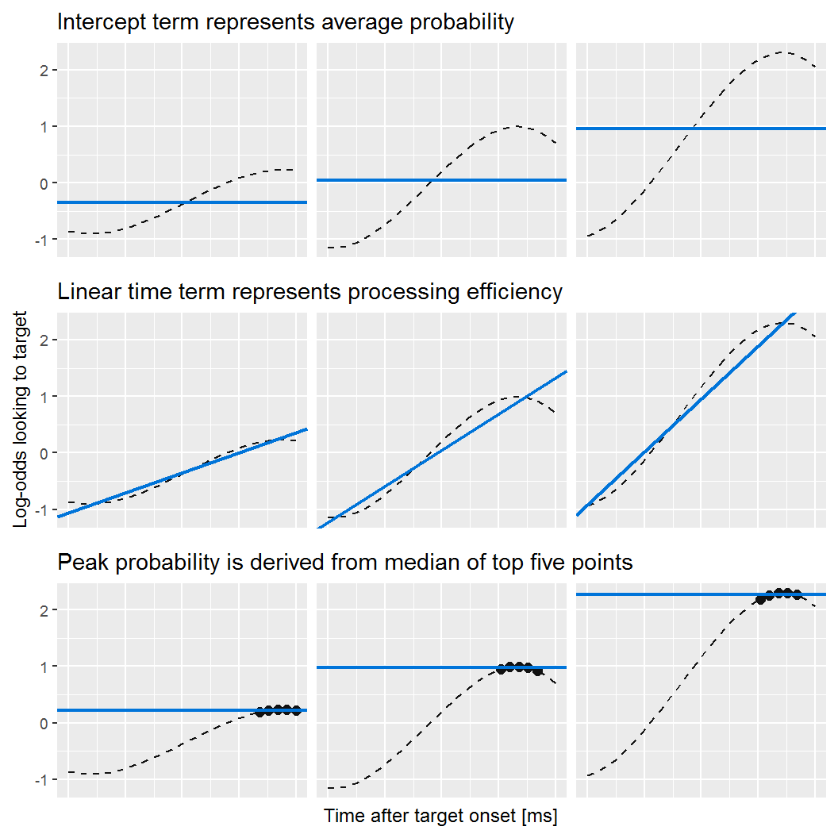
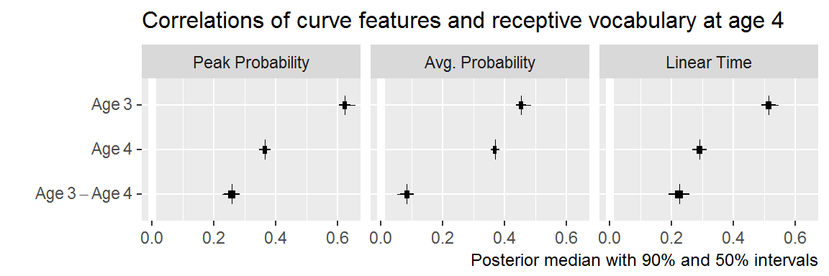
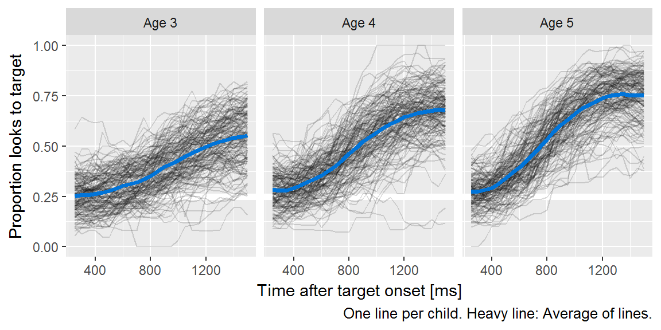
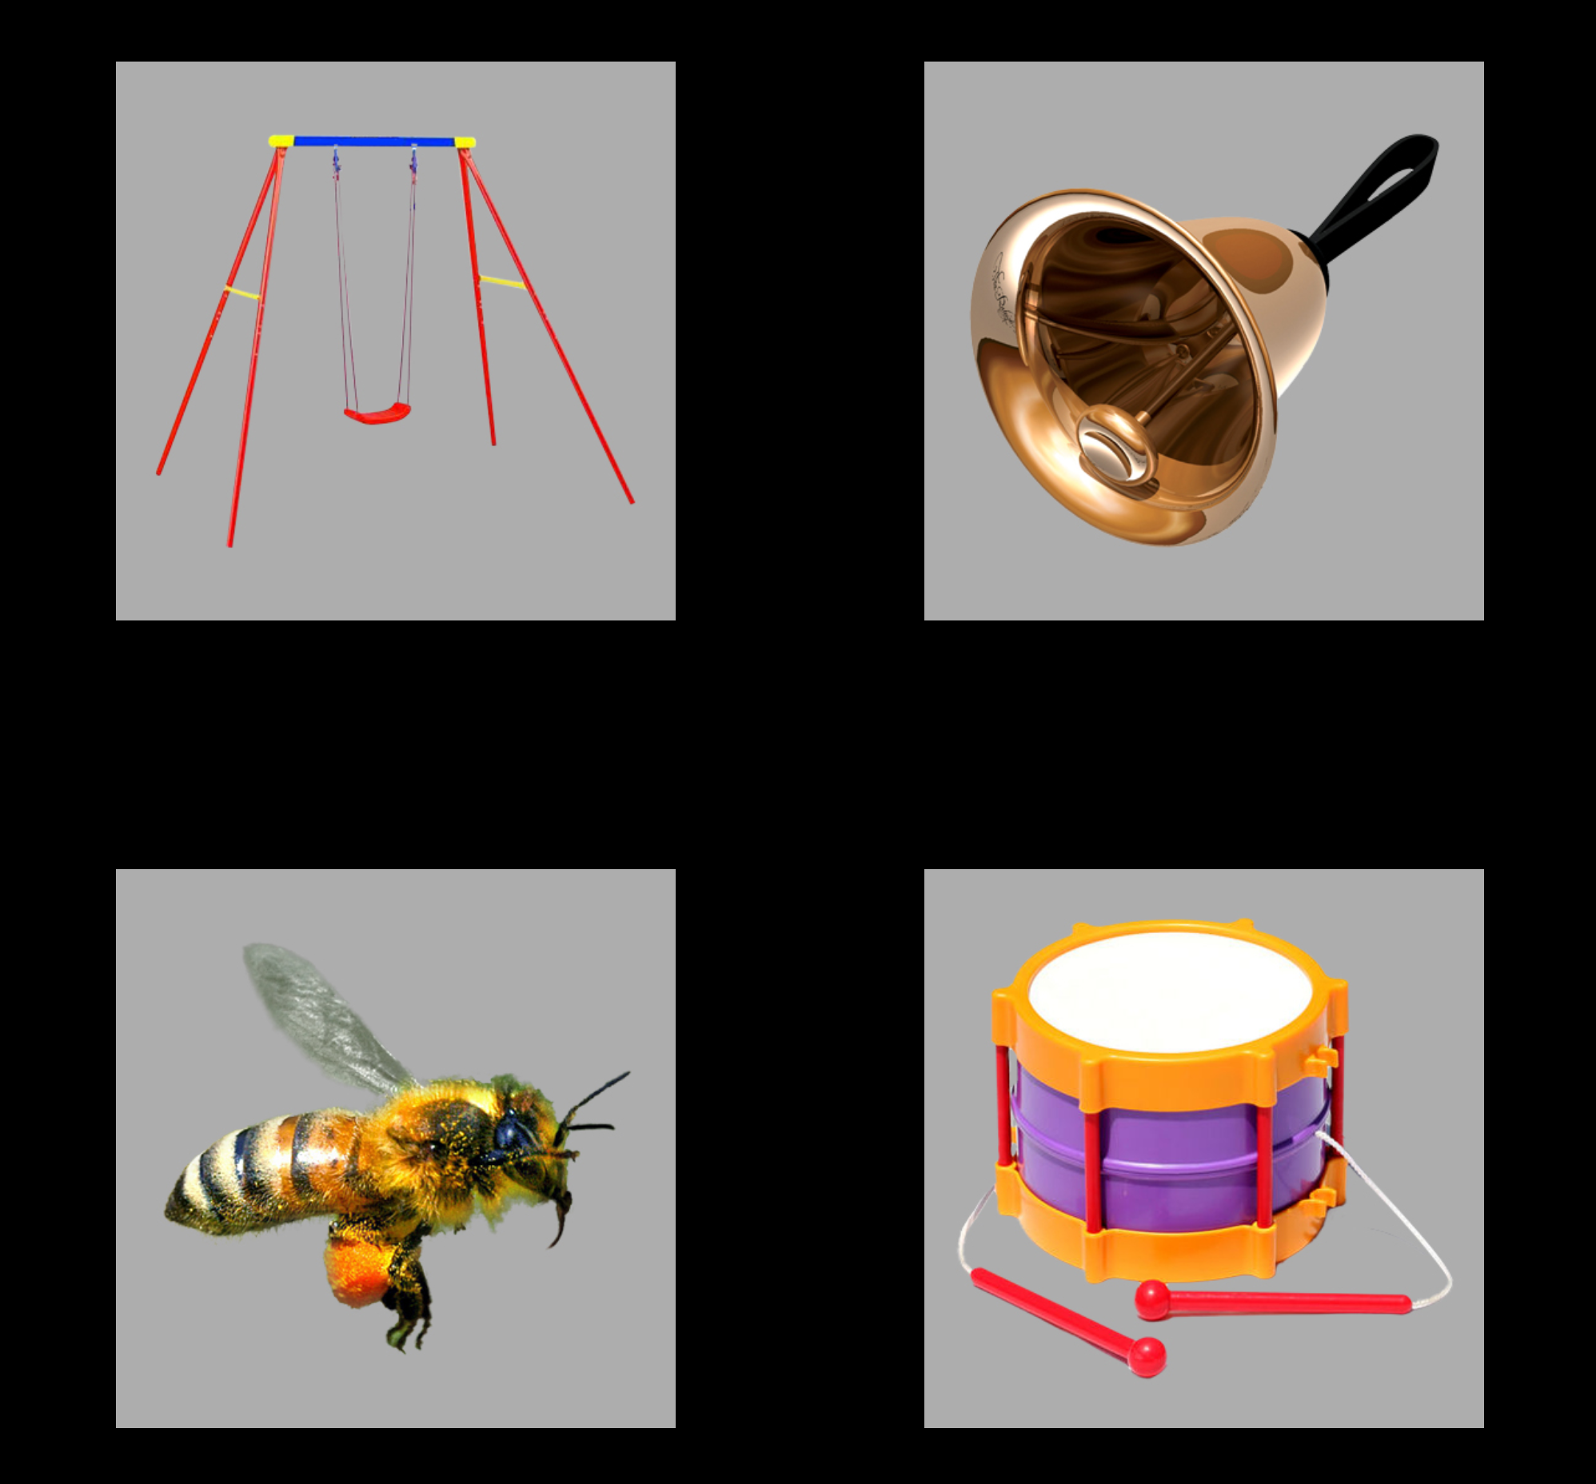
Development of familiar word recognition
in preschoolers
Tristan Mahr, University of Wisconsin–Madison Jan Edwards, University of Maryland
Background
Recent work suggests word recognition efficiency—how well children map incoming speech to words—may help identify early differences in children’s language trajectories
We do not know, however, how word recognition itself develops over time or how individual differences in word recognition change over time.
Current study
How does familiar word recognition develop over the preschool years?
Are whether individual differences in word recognition were stable over developmental time?
How do early word recognition differences predict later vocabulary outcomes?
Method
Participants
Data collected during a three-year longitudinal study.
Procedure
Children heard a familiar word in a carrier phrase (e.g., “find the bell”) and saw an array of photos, including a target, a semantic, a phonological, and an unrelated competitor.
Tobii T60XL eyetracker measured children’s patterns of looking to objects over the course of a trial.
This procedure measures a child’s real-time comprehension of words by capturing how the child’s gaze location changes over time in response to speech.
Growth curve analysis
Bayesian mixed effects logistic regression.
Estimated a growth curve for each child x year.
Used growth curve features to measure individual differences in word recognition.
Time Point | Children | Age (months) Mean ± SD | Age (months) Range | EVT-2 standard Mean ± SD
Age 3 | 149 | 33 ± 3.5 | 38–39 | 113 ± 18
Age 4 | 162 | 45 ± 3.5 | 39–52 | 118 ± 16
Age 5 | 153 | 57 ± 3.7 | 51–66 | 118 ± 15
Conclusions
Children’s word recognition improved each year.
Individual differences in word recognition were stable over time, so that relatively fast children at Age 3 remained relatively fast at Age 5.
Early differences did not wash out even as children began to converge on a more mature level of performance.
Individual differences were highly predictive: The best predictors of Age 5 vocabulary were measures of Age 3 word recognition efficiency.
“Find the bell!”
Unrelated competitor
(swing)
Target noun
(bell)
The authors have no financial or non-financial conflicts of interest.
Funding was provided by R01 DC012513 and P30 HD03352 (Waisman Center).
Symposium on Research in Child Language Disorders
Madison, WI: June, 2018
Contact: Tristan Mahr (tristan.mahr@wisc.edu)
Phonological competitor
(bee)
Semantic competitor
(drum)
(Marchman & Fernald 2008; Fernald & Marchman, 2012)
Sentence describing result.
Detail
Sentence describing result. Detail.

